Slide 1
Chapter 9
Tests of Hypotheses for a Single Sample

Slide 2
Introduction
Now we talk about investigating claims about the values of a parameter versus interval estimates. Methods for deciding between contradictory claims about a parameter is called hypothesis testing.

Slide 3
Hypotheses and Test Procedures
Hypothesis - claim or belief about a parameter
or parameters.
EXA A large complex of apartments advertise an
average size of 1250 square feet. A
tenant’s group believes that it is smaller
than that.

Slide 4
The Hypotheses
H₀ - null hypothesis - complement of the
claim H₁
H₁ - alternative hypothesis - claim or belief
EXA (cont.) μ = mean area of apartments in
the complex
The hypotheses are: H₀ : μ ≥ 1250
H₁ : μ < 1250

Slide 5
Test Procedure
Test procedure involves two components:
(1) Test statistic (T.S.) - function of a random
sample which is used to determine whether
or not to reject H₀.
(2) Rejection region (R.R.) - set of values of
the T.S. for which we reject H₀. (also
called critical region)

Slide 6

Back to Example
A SRS of 50 apartments in the complex is measured resulting in a sample mean of 1240 square feet. Should we reject H₀?
Since = 1240, there is reason to believe that
μ < 1250 (since is a point estimate of μ).
The issue is not only that is below 1250 but
it has to be sufficiently below 1250.

Slide 7
Two Types of Errors
actual unknown situation
H₀ is true H₀ is false
Test Reject H₀
concludes
Fail to
reject H₀
Type I error | OK
__________________________
OK | Type II error

Slide 8
Definitions
Type I error - reject H₀ when H₀ is true
Type II error - fail to reject H₀ when H₀ is false
Significance level (denoted by α) - maximum type I error probability
β(θ) = P(Type II error assuming θ is the value of
the parameter)
Notes:
Note that α is also called the size of the test.

Slide 9
Example
EXA Let p denote the proportion of all registered voters in a certain area who favor candidate A over candidate B in the race for county supervisor. Test H₀: p = .5
H₁: p ≠ .5.
We have a SRS of 25 registered voters. Let X denote the number in the sample who favor A.
We reject H₀ when X ≤ 7 or X ≥ 18.

Slide 10
Example
EXA (cont.) H₀: p = .5
H₁: p ≠ .5.
n = 25. Reject H₀ when X ≤ 7 or X ≥ 18.
a. Find α.
b. Find β(.3).
c. State conclusion if X was observed to be
x = 6.
Notes:
a. α = P_{.5} (X ≤ 7 or X ≥ 18) = P_{.5} (X ≤ 7) + P_{.5} (X ≥ 18) (using R)
= .0216 +.0216 = .0432
> pbinom(7,25,.5)
[1] 0.02164263
> 1-pbinom(17,25,.5)
[1] 0.02164263
b. β(.3) = P_{.3} (8 ≤ X ≤ 17) = P_{.3} (X ≤ 17) - P_{.3} (X ≤ 7) = .4881 (using R)
> pbinom(17,25,.3)-pbinom(7,25,.3)
[1] 0.4881334
c. State conclusion if X was observed to be x = 6.
6 is in rejection region so reject H₀ at α = .0432

Slide 11
Examplle
EXA Let X denote the weight of 10-kg weight by a particular scale. We weigh this weight 25 times. Assume the weights are normal and σ = 0.2 kg. We want to see if there is evidence the scale is not working properly and needs recalibrated.
a. Give the hypotheses to be tested.
Notes:
a. H₀: μ = 10
H₁: μ ≠ 10

Slide 12
Example
EXA Suppose the scale is to be recalibrated (i.e., reject H₀) when ≥ 10.1032 or ≤ 9.8968.
b. Find the probability that recalibration is carried out when it is actually unnecessary.
(this is α - why?)
Notes:
b. α = P_{μ=10}[ ≥ 10.1032 or ≤ 9.8968] =
= P[Z ≥ (10.1032 - 10)/(.2/√25)] + P[Z ≤ (9.8968 - 10)/(.2/√25)]
= P[Z ≥ 2.58] + P[Z ≤ -2.58] = 2(.0049) = .0098

Slide 13
Example
EXA Suppose the scale is to recalibrated (i.e., reject H₀) when ≥ 10.1032 or ≤ 9.8968.
c. Find β(10.1).
d. Let Z = ( - 10)/(σ/√n). Find c such that
rejection region above is equivalent to
Z ≥ c or Z ≤ -c.
Notes:
c. β(10.1) = P_{μ=10.1}[ 9.8968 < < 10.1032] =
= P[ (9.8968 - 10.1)/(.2/√25) < Z < (10.1032 - 10.1)/(.2/√25)]
= P[-5.08 < Z < .08] ≈ .5319
d. From calculation in part b, we see that c = 2.58. Note this rejection
region is equivalent to |Z| ≥ 2.58.

Slide 14
Power of a Test
π_{t}(θ) = P_{θ}(Reject H₀) = Power of a test
When H₀ is true, the power ≤ α.
When H₀ is false, the power = 1 - β(θ) .
The power of a test has values betwee 0 and 1. Also, α = max π_{t}(θ) , where the maximum is taken over values of θ where H₀ is true.
When H₀ is false, we want large power.

Slide 15
Tests for a Normal Mean
First, assume X₁ ,…,X_{n} is a random sample
from a N(μ, σ²) where μ is unknown and σ² is
known.
Consider testing:
I. H₀: μ ≤ μ₀ II. H₀: μ ≥ μ₀ III. H₀: μ = μ₀
H₁: μ > μ₀ H₁: μ < μ₀ H₁: μ ≠ μ₀

Slide 16
Test Statistic
Test Statistic is Z = - μ₀
σ/√n
Note: If μ = μ₀, Z ~ N(0,1).

Slide 17
Tests for a Normal Mean
Consider case I. It makes sense that we
should reject H₀ when Z is sufficiently large
(i.e., Z ≥ c). Why??? What is c?
α = max P(Type I error) = max P(Z ≥ c)
μ≤μ₀
= max P(Z ≥ c) ⇒ c = z_{α}
μ=μ₀
Notes:
Make picture.

Slide 18
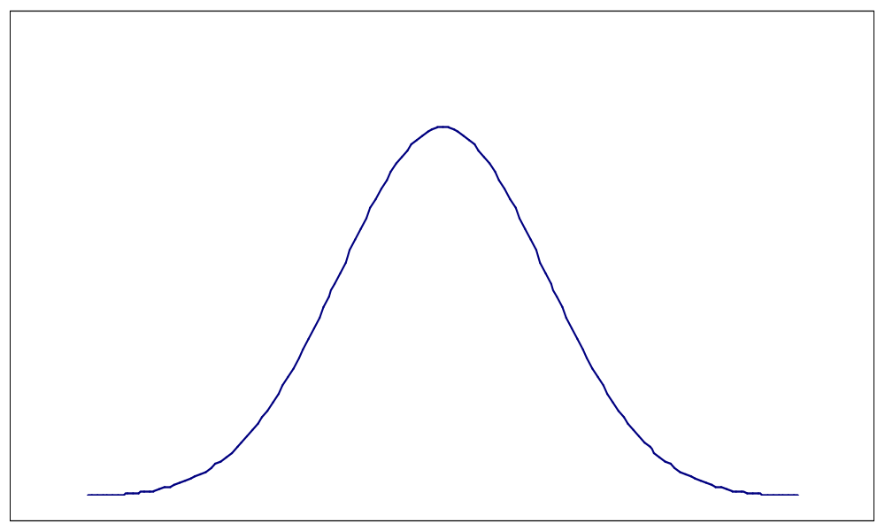
Recall z_{α} Notation
|
α
______________________________________
|
|
0
z_{α}

Slide 19
Rejection Regions
In summary, reject H₀ when
I. Z ≥ z_{α} II. Z ≤ -z_{α} III. |Z| ≥ z_{α/2}
When testing hypotheses, we will go through
six steps.

Slide 20
Example
EXA # 9.50, page 331.
n = 70, σ = 9, and = 274.3
Hospital wonders whether there is evidence that their patients are at risk of premature birth.
Step 1 Give the parameter of interest
μ = mean gestation period of pregnant women at this hospital

Slide 21
Example
Step 2 Give the hypotheses to be tested
H₀: μ ≥ 280
H₁: μ < 280
Step 3 Give the Test Statistic
Z = - 280 = - 280
σ/√n 9/√70

Slide 22
Example
Step 4 Give the Rejection Region (α = .05)
Reject H₀ when Z < - z_{.05} = -1.645
<------|--------|-----
-1.645 0

Slide 23
Example
Step 5 Find the observed test statistic
z_{OBS} = 274.3 - 280 = -5.30
9/√70
-5.30
↓
<------|--------|------
-1.645 0

Slide 24
Example
Step 6 State Conclusion
Reject H₀ at α = .05. So there is evidence that the true mean gestation period of pregnant women at this hospital is below 280 days.
(b) If μ is in fact 277 , find the probability of
rejecting H₀ when α = .05 and n = 70.
Notes:
P_{μ=277} [( - 280)/(9/√70) < -1.645 ]
= P_{μ=277} [ < -(1.645)(9/√70) + 280]
= P_{μ=277} [ < 278.23)
= P[Z < (278.23 – 277)/(9/√70)]
= P(Z < 1.14) = 0.8729
This is power of test when μ = 277. If μ = 277, we would want to reject the null hypothesis.
In this case β(277) = 1 - .8729 = 0.1271.

Slide 25
β and Sample Size
Case I
Type II error probability for α level test
β(μ’) = Φ[z_{α} + (μ₀ - μ' )/(σ/√n)]
n for α level test where β(μ' ) = β
n = [ σ (z_{α} + z_{β} ) / (μ₀ - μ' ) ]²

Slide 26
β and Sample Size
Case II
Type II error probability for α level test
β(μ’) = 1 - Φ[ -z_{α} + (μ₀ - μ' )/(σ/√n)]
n for α level test where β(μ' ) = β
n = [ σ (z_{α} + z_{β} ) / (μ₀ - μ' ) ]²

Slide 27
β and Sample Size
Case III
Type II error probability for α level test
β(μ’) = Φ[ z_{α/2} + (μ₀ - μ' )/(σ/√n)]
- Φ[ -z_{α/2} + (μ₀ - μ' )/(σ/√n)]

Slide 28
β and Sample Size
Case III
n for α level test where β(μ' ) = β
n = [ σ (z_{α/2} + z_{β} ) / (μ₀ - μ' ) ]²
(approximate answer)

Slide 29
Example
EXA Find β(277) in gestation period example using formula
β(μ’) = 1 - Φ[ -z_{α} + (μ₀ - μ' )/(σ/√n)] .
Also, find n such that β(277) = 0.1
Notes:
β(277) = 1 – Φ[ -1.645 + (280 - 277 )/(9/√70)]
= 1 - Φ(1.14) = 1 - .8729 = .1271
Hence, P_{μ=277} [reject H₀ ] = 1 - β(277) = 1 - .1271 = .8729
n = [ σ (z_{α} + z_{β} ) / (μ₀ - μ' ) ]² = [ σ (z_{.05} + z_{.1} ) / (μ₀ - μ' ) ]²
= [ (9) (1.645 + 1.28 ) / (280 - 277 ) ]²
= 77.001→ 78

Slide 30
Tests for a Population Mean
Now assume X₁ ,…,X_{n} is a random sample
from some population where μ is unknown,
σ² is unknown, and n is large.
Recall the hypotheses to be tested:
I. H₀: μ ≤ μ₀ II. H₀: μ ≥ μ₀ III. H₀: μ = μ₀
H₁: μ > μ₀ H₁: μ < μ₀ H₁: μ ≠ μ₀

Slide 31
Tests for a Population Mean
Test Statistic is Z = - μ₀
S/√n
Note: If μ = μ₀, Z is approximately N(0,1).
Rejection regions are as before using the
above definition of Z.
Notes:
Write down rejection regions in case students have forgot.

Slide 32
Example
EXA A sample of 40 speedometers of a particular brand is obtained, and each is calibrated to check for accuracy at 55 mph. The resulting sample mean and sample standard deviation are 55.6 and 1.3, respectively. Is this evidence that the true mean exceeds 55 mph? Test using α = .05.
Go through the 6 steps.
Notes:
1. μ = true mean reading when actual speed is 55 mph
2. H₀ : μ ≤ 55
H₁ : μ > 55
3. T.S. is Z = - 55
S/√n
4. Reject H₀ when Z > z_{.05} = 1.645
5. z_{OBS} = 55.6 - 55 = 2.92
1.3/√40
6. Reject H₀ at α = .05. Hence, we have evidence that μ > 55.

Slide 33
Tests for a Normal Mean
Now assume X₁ ,…,X_{n} is a random sample
from a N(μ, σ²) where μ and σ² are unknown.
Test Statistic is T = - μ₀
S/√n
Note: If μ = μ₀, T is t(n - 1).

Slide 34
Tests for a Normal Mean
We reject H₀ when
I. T > t_{α,n-1} II. T < -t_{α,n-1} III. |T| > t_{α/2,n-1}
Use Table V in Appendix.

Slide 35
Example
EXA Variable of interest is time for inspector’s eyes (in seconds) to adapt to reduced lighting.
n = 9, = 6.32, s = 1.65
Assuming normal data, is there evidence that
the mean adaptation time is below 7 seconds.
Test at α = .1.
Notes:
1. μ = mean adaptation time
2. H₀ : μ ≥ 7
H₁ : μ < 7
3. T.S. is T = - 7
S/√n
4. Reject H₀ when T < -t_{.1,8} = -1.397
5. t_{OBS} = 6.32 - 7 = -1.24
1.65/√9
6. Fail to reject H₀ at α = .1. Hence, there is no evidence that μ < 7.

Slide 36
Example Using R
EXA An individual’s phosphate level varies over time and is normally distributed. Let μ denote the mean phosphate level for a particular person. Joe’s phosphate level for six different days are:
5.6 5.1 4.6 4.8 5.7 6.4.
Is there evidence that Joe’s mean phosphate level exceeds 5? Test at α = .05.

Slide 37
Example Using R
EXA μ = mean phosphate level for Joe
5.6 5.1 4.6 4.8 5.7 6.4.
Is there evidence that Joe’s mean phosphate level exceeds 5? Test at α = .05.
H₀: μ ≤ 5
H₁: μ > 5

Slide 38
R Code
x=c(5.6,5.1,4.6,4.8,5.7,6.4)
t.test(x,mu=5,alternative="greater")

Slide 39
R Output
> x=c(5.6,5.1,4.6,4.8,5.7,6.4)
> t.test(x,mu=5,alternative="greater")
One Sample t-test
data: x
t = 1.3499, df = 5, p-value = 0.1175
alternative hypothesis: true mean is greater than 5
95 percent confidence interval:
4.819338 Inf
sample estimates:
mean of x
5.366667

Slide 40
Tests on σ² and σ for Normal
Assume that X₁ ,…,X_{n} is a random sample from a N(μ, σ²) distribution.
Thm (n - 1)S² / σ² = Σ(X_{i} - )² / σ² has a
chi-squared distribution with (n - 1)
degrees of freedom. (χ² (n - 1))
The normal assumption is very important here.
Notes:
Discussed this theorem before when discussing confidence intervals.

Slide 41

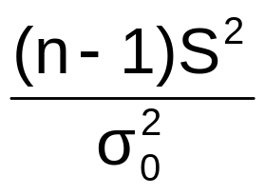
Tests on σ² for Normal
We want to test:
I.H₀: σ² ≤ σ²₀ II.H₀: σ² ≥ σ²₀ III.H₀: σ² = σ²₀
H₁: σ² > σ²₀ H₁: σ² < σ²₀ H₁: σ² ≠ σ²₀
T.S. is = .

Slide 42
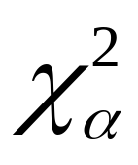
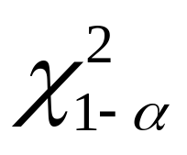
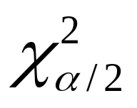
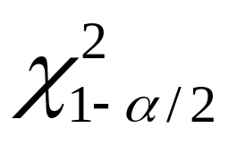
Tests on σ² for Normal
Reject H₀ when
I. > II. <
III. > or <
The chi-square values are based on (n – 1) d.f. Use Table IV in Appendix.

Slide 43
Example
EXA Random variable of interest is amount (in mls) of lateral expansion pulsed-power gas metal arc welds used in LNG ship containment tanks.
n = 9, s = 2.81
It is important that the variance is at most 5. Is there evidence to doubt this? Test using α = .05.
Notes:
NEED TO ASSUME NORMAL DATA.
H₀ : σ² ≤ 5
H₁ : σ² > 5
Reject H₀ when > χ²_{.05,8} =15.51.
-OBS = 8(7.8961)/5 = 12.63376
Fail to reject H₀ at α = .05. No evidence to doubt that the variance is at most 5.

Slide 44
Tests concerning p
X = # of S’s out of n independent trials.
X ~ Bin(n,p)
We want to test:
I. H₀: p ≤ p₀ II. H₀: p ≥ p₀ III. H₀: p = p₀
H₁: p > p₀ H₁: p < p₀ H₁: p ≠ p₀

Slide 45


Large Sample Tests
Test statistic is Z = - p₀ .
If p = p₀, Z is approximately N(0,1) when
np₀ and n(1 - p₀) are both at least 10.
Notes:
Note definition of Z on page 345.

Slide 46
Large Sample Tests for p
For case I, α = P(Z ≥ c where p = p₀).
⇒ c = z_{α}
We reject H₀ when
I. Z > z_{α} II. Z < -z_{α} III. |Z| > z_{α/2}

Slide 47
EXA Let S denote when a current customer qualifies to be a member in an executive traveler’s club. A random sample of size 500 is taken where only 40 qualify.
n = 500 x = 40
Test at level .01 to see if there is evidence
that the airline’s premise that 5% would
qualify is false.
Notes:
1. p = proportion of current customers that would qualify for executive
traveler’s club
2. H₀ : p = .05
H₁ : p ≠ .05 = 40/500 = .08
3. T.S. is Z = - .05
√(.05)(.95)/n
4. Reject H₀ when |Z| > z_{.005} = 2.576
5. z_{OBS} = .08 - .05 = 3.08
√(.05)(.95)/500
6. Reject H₀ at α = .01. Hence, we have evidence that the proportion
differs from .05.

Slide 48
Small Sample Tests
When np₀ or n(1 - p₀) is less than 10, the
Binomial distribution must be used to
determine the rejection region .
Notes:
Skipping formulas for β and n but they are given in section 5. Those formulas assume large sample size.

Slide 49
Example
Assume X is Bin(10,p). Test H₀ : p ≥ .4
H₁: p < .4
Let α = .05.
Reject H₀ when X ≤ c.
α ≥ maxP(X ≤ c) = P_{p = .4} (X ≤ c) = .0464
p ≥ .4
So use c = 1.

Slide 50
P-values
Defn P-value = observed significance level -
smallest significance level for which H₀
would be rejected on the basis of what
is observed.
The P-value is a probability.

Slide 51
How to use P-values
For a pre-specified α,
(1) P-value ≤ α ⇔ reject H₀ at level α
(2) P-value > α ⇔ fail to reject H₀ at level α

Slide 52
P-values
EXA Test H₀ : μ ≥ 10 T.S. is Z = - 10
H₁ : μ < 10 σ/√n
Say z_{OBS} = -2.
α Rejection Region Conclusion
.05 Z ≤ -1.645 Reject H₀
.025 Z ≤ -1.96 Reject H₀
.01 Z ≤ -2.33 Fail to reject H₀

Slide 53
P-values
Here P-value = P(Z ≤ -2) = .0228. < .05
< .025
> .01
P-value when using Z (N(0,1) as T.S.:
I. P(Z ≥ z_{OBS}) II. P(Z ≤ z_{OBS}) III. P(|Z| ≥ |z_{OBS}|)

Slide 54
Example
EXA If 15 of 60 specimens yield before the theoretical yielding point, is there evidence that more than 20% of all specimens yield before the theoretical yielding point? Test at α = .05.
Notes:
1. p = proportion of all specimens that yield before theoretical point
2. H₀ : p ≤ .2 = 15/60 = .25
H₁ : p > .2
3. T.S. is Z = - .2
√(.2)(.8)/n
4. Reject H₀ when Z > z_{.05} = 1.645
5. z_{OBS} = .25 - .2 = .97
√(.2)(.8)/60
6. Fail to reject H₀ at α = .05. No evidence to modify production
process.
P-value = P(Z > .97) = .1660

Slide 55
P-values for t Test Statistic
I. P(T ≥ t_{OBS}) II. P(T ≤ t_{OBS}) III. P(|T| ≥ |t_{OBS}|)
We will only be able to get bounds for the
P-value here.

Slide 56
Example
EXA Variable of interest is the reading of a
spectrophotometer on a manufactured gas in
which the CO concentration is very precisely
controlled at 70 ppm. On the basis of 6
readings with mean 75.5 and standard deviation
7.00714, is there evidence that the
spectrophotometer is not working properly?
Assuming normal data, test at α = .05.
Notes:
1. μ = mean reading of manufactured gas by spectrophotometer
2. H₀ : μ = 70 = 75.5, n = 6, s = 7.00714
H₁ : μ ≠ 70
3. T.S. is T = - 70
S/√n
4. Reject H₀ when |T| > t_{.025, 5} = 2.571
5. t_{OBS} = 75.5 - 70 = 1.923
7.00714/√6
6. Fail to reject H₀ at α = .05. No evidence that spectrophotometer is
not working properly.
P-value = P(|T| > 1.923) is between .1 and .2. (So P-value > .05)

Slide 57
Using R
EXA Find P-value = P(|T| > 1.923) using R.
> 2*pt(-1.923,5)
[1] 0.1124951
Note that P-value is between 0.1 and 0.2.

Slide 58
Tests and Confidence Intervals
How do we use a c.i. to test a case III?

Slide 59
Summary Table
Summary table is given in inside of back cover. We have done first page so far.

